Slide 1

THE HUMAN FIREWALL
How to Stay Sane When Your Job is to Expect the Worst
Zahira Sughra Zainuddin
Chief Human-Centric Catalyst
Rumi
Zahira Sughra Zainuddin

Slide 2
“51 seconds”
Internal

Slide 3
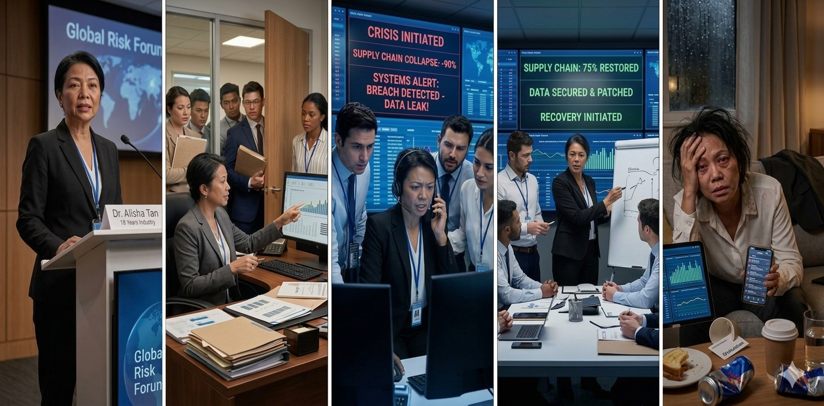
The Expert
The Go-To-Person
The Crisis
The Recovery
The Burnout

Slide 4
“who spots the
storms inside you?”
Internal

Slide 5
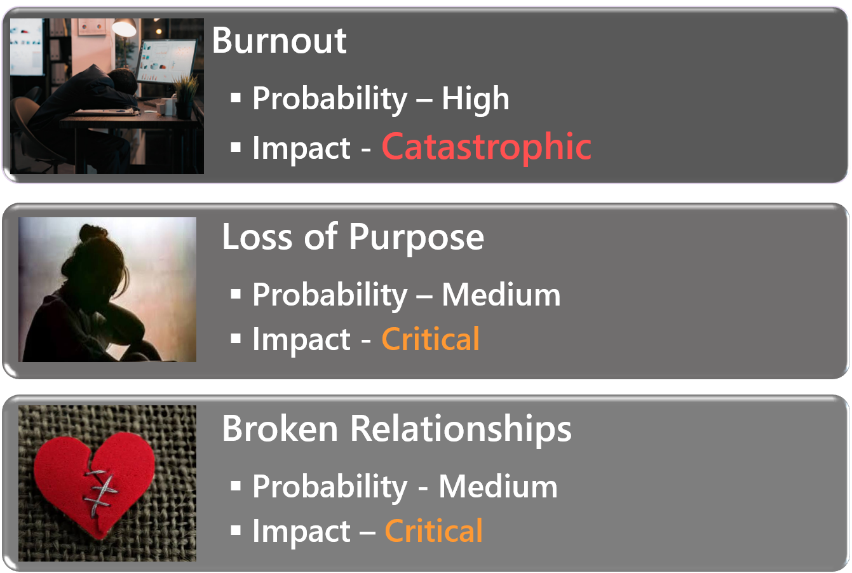
Me.Inc.
The Risk Register We Never Write

Slide 6
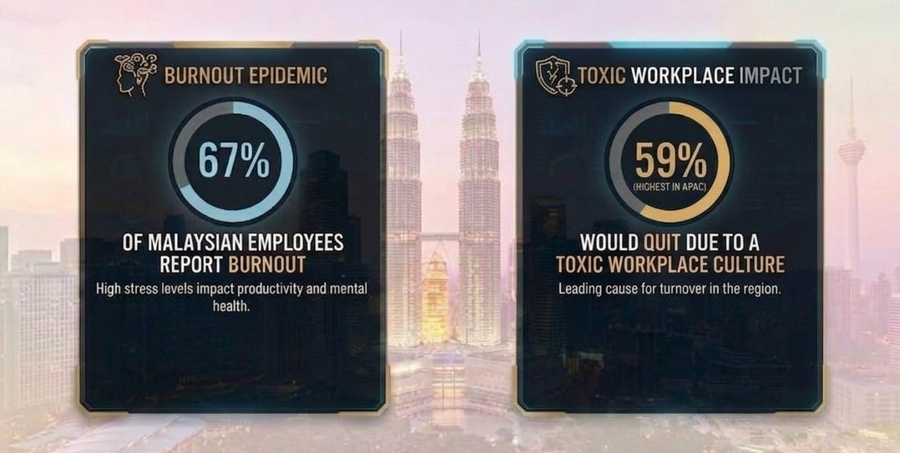
The Reality Check – Malaysia’s Hidden Risk
Internal

Slide 7
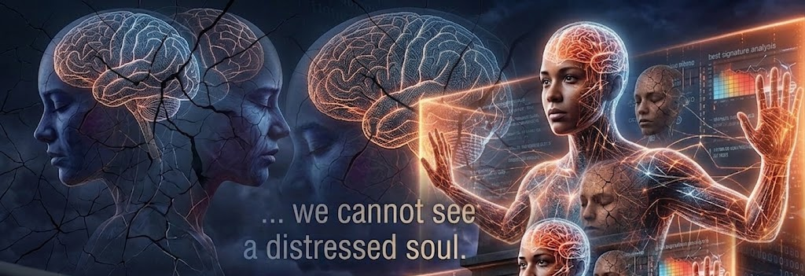
Mental health is an invisible hazard…
Internal

Slide 8



Your Toolkit
Building your Human Firewall
Energy Management
Adaptive Thinking
Emotional Agility

Slide 9



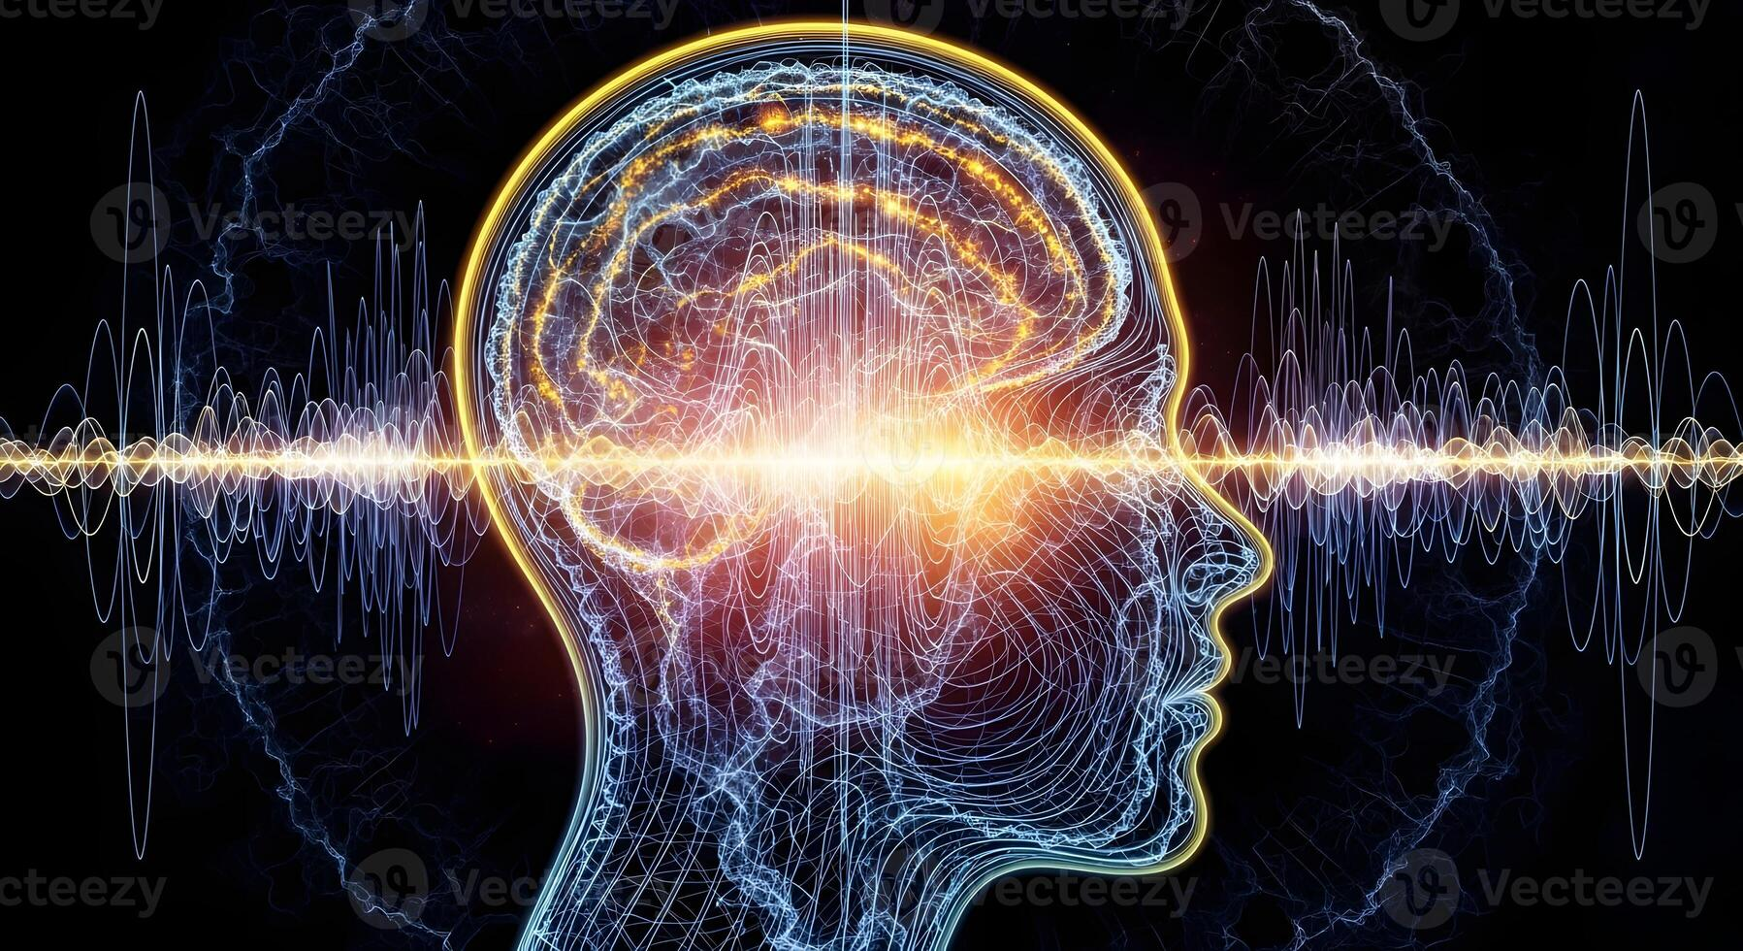

Toolkit #1
wellness
emotions
mind
spiritual
Your
Energy Quadrant

Slide 10
Toolkit #2
Adaptive Thinking
Flexibility isn't weakness. It's survival.
What can I control?
What can I let go?
What must I reframe?
Internal

Slide 11
Toolkit #3
Emotional Agility
Feel it. Let it move through you.
I see you.
I hear you.
Now, what do I do with you?
Internal

Slide 12

Internal

Slide 13
Me.Inc.
my Personal Resilience Charter
“I will build my firewall by:
Energy Management
I will protect my internal energy by…
Adaptive Thinking
I will practice adaptive thinking by…
Emotional Agility
I will honour my emotions by… “

Slide 14



Slide 15
“ Yesterday I was clever, so I wanted to change the world. Today I am wise, so I am changing myself. ”
- Rumi
Internal

Slide 16
Q&A
Internal

