Slide 1



MALAYSIAN CYBERSECURITY ACT 2024 (ACT 854)
29 JULY 2026
The Impact on Risk Managers

Slide 2

Facts, Financials & Legislation

Slide 3
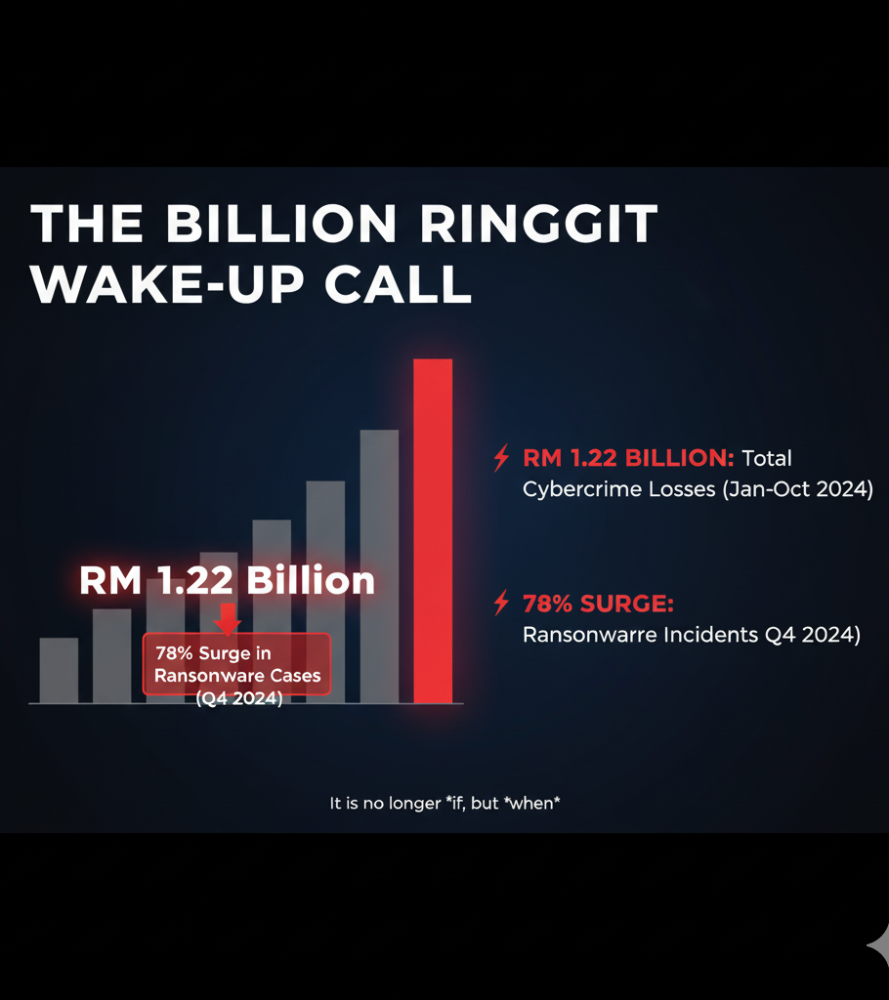
The Cost
  Financial Services sector has the highest average breach cost of any industry—USD 5.57 million (approx. RM 24.7 million) per incident.*
  Organizations that detect and contain a breach in <200 days save an average of $1.39 million (approx. RM 6.1m) **.
*Business World Online, 8 August 2024
**IBM’s 2024 Cybersecurity Report
Speed isn't just for IT; it’s a direct hit to the balance sheet.

Slide 4
The Cost
Cyber Incident Statistics Reported to Cybersecurity Malaysia (Q1-Q4 2024)
Category | Q1 2024 | Q2 2024 | Q3 2024 | Q4 2024 | Total Reported
Data Breach | 142 | 162 | 168 | 151 | 623
Fraud | 1,025 | 1,114 | 1,139 | 1,108 | 4,386
Intrusion | 48 | 65 | 71 | 75 | 259
Intrusion Attempt | 38 | 58 | 140 | 97 | 333
Malicious Codes | 111 | 91 | 57 | 42 | 301
Other Categories | 191 | (not specified) | (not specified) | (not specified) | 317
TOTAL | 1,555 | 1,481 | 1,623 | 1,550 | 6,219
In 2024, Malaysia experience a significant surge in cyber threats.
Over 19.6 million web-based attacks in the first half of the year.
153% increase in ransomware incidents compared to the previous year.
Note: The numbers in the table represent incidents reported to MyCERT and only reflect the total handled by their centre, not all incidents nationwide.

Slide 5
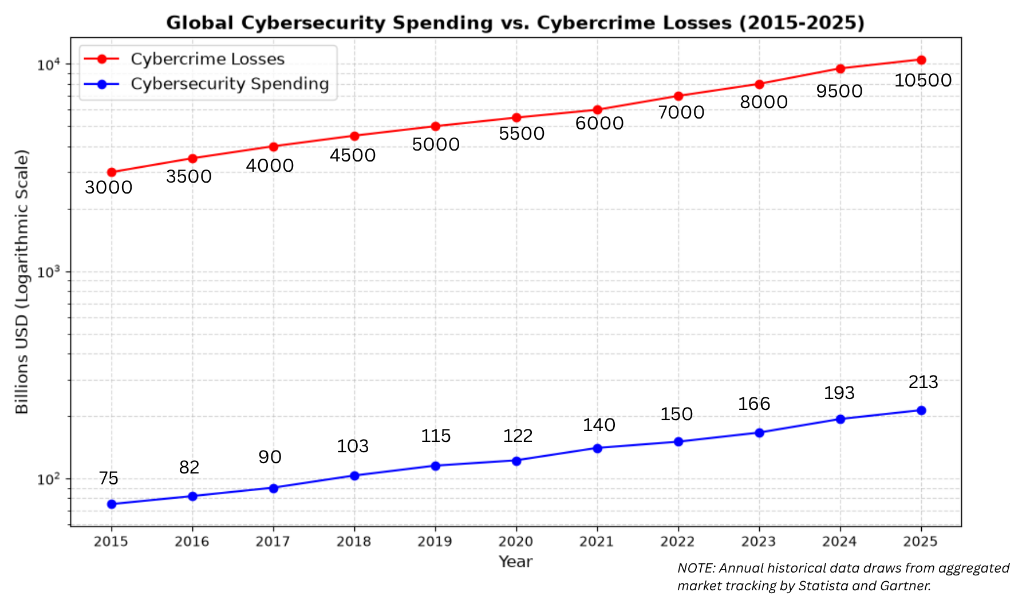

Slide 6
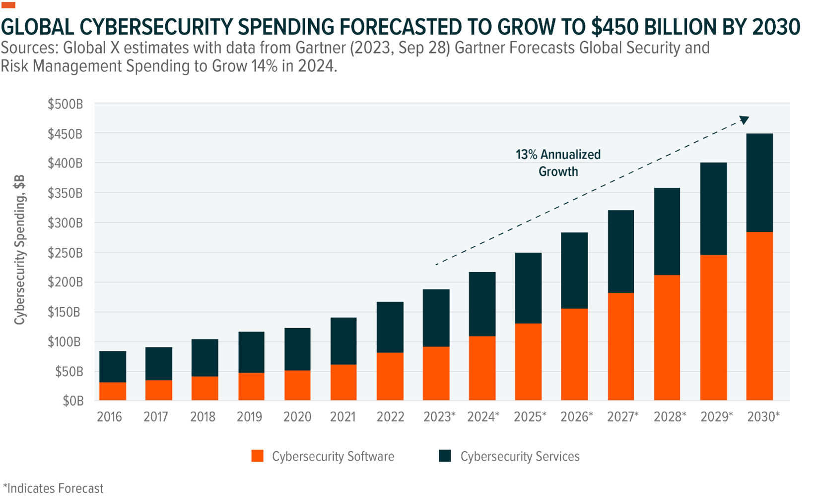

Slide 7
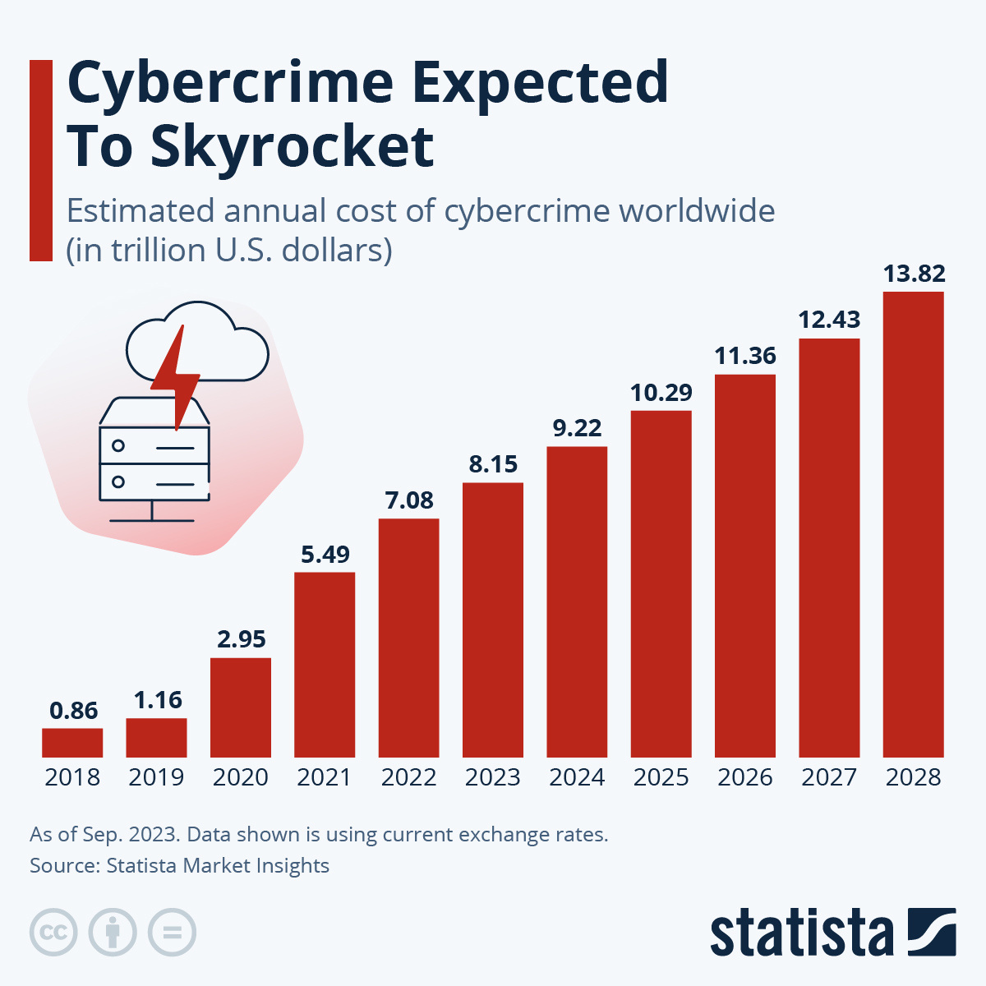

Slide 8
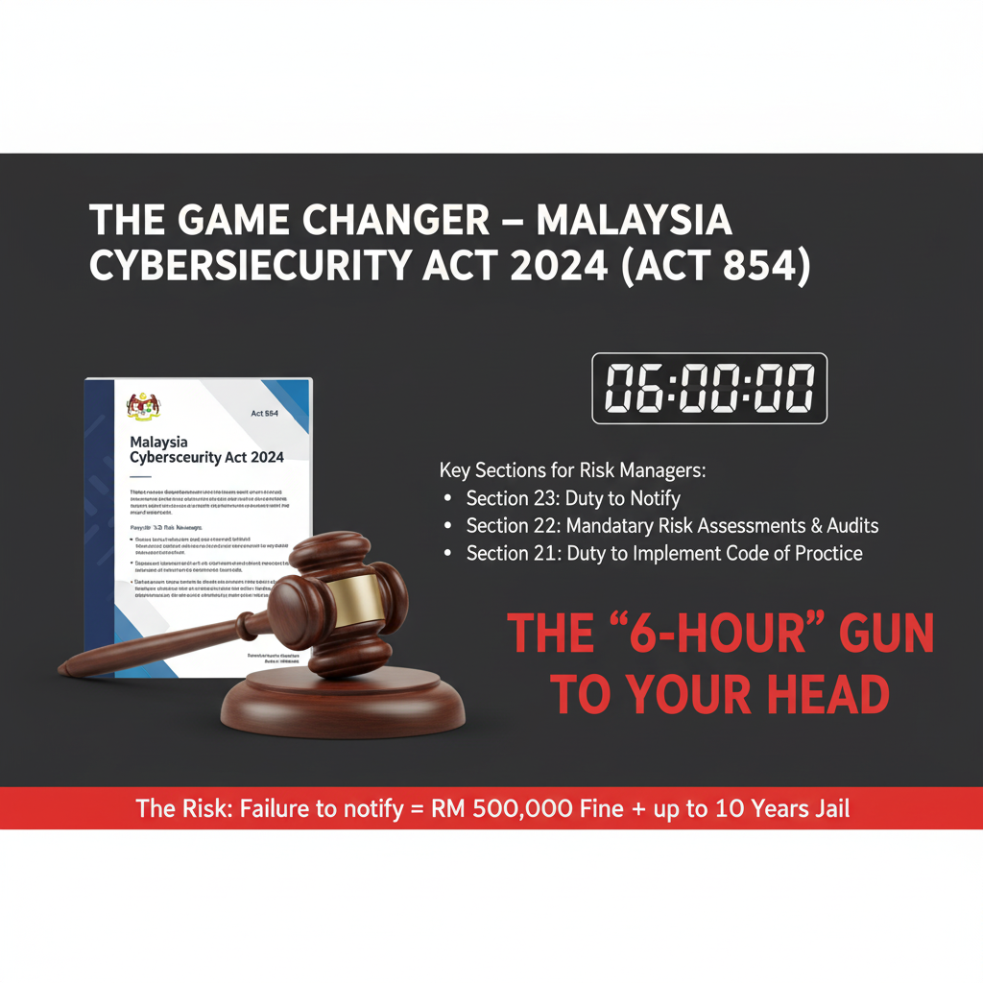
THE GAME CHANGER - MALAYSIA CYBERSECURITY ACT 2024 (ACT 854)
Key sections for Risk Managers:
  Section 21: Duty to Implement Code of Practice
  Section 22: Mandatory Risk Assessments & Audits
  Section 23: Duty to Notify

Slide 9
Duty to Implement Code of Practice
Core Message
The Duty
The Flexibility (Limited)
"Good enough" is dead. You must meet the specific technical Code of Practice for your sector.
An NCII entity shall implement the measures, standards, and processes specified in the Code of Practice.
You can use alternative measures, but only if you prove they offer equal or higher protection.
The Penalty: Non-compliance = RM 500,000 Fine + Up to 10 Years Jail.

Slide 10
Duty to Implement Code of Practice
For Banking & Financial Institutions (BNM)
The Code: Policy Document on Risk Management in Technology (RMiT).
Status: This is the primary directive. BNM regulates cybersecurity through the RMiT framework.
Key Requirement: The Act makes adherence to RMiT not just a regulatory expectation but a matter of national security law.
  Note: BNM also enforces the Management of Customer Information and Permitted Disclosures (MCIPD) for data protection aspects.
The Penalty: Non-compliance = RM 500,000 Fine + Up to 10 Years Jail.

Slide 11
Duty to Implement Code of Practice
For Capital Market Entities (Securities Commission)
The Code: Guidelines on Technology Risk Management (GTRM).
Status: Recently revised (August 2024) specifically to align with the Cyber Security Act 2024.
Key Requirement: Paragraphs within these Guidelines regarding cyber risk management, access control, and data protection are now legally enforceable under the Cyber Security Act 2024.
The Penalty: Non-compliance = RM 500,000 Fine + Up to 10 Years Jail.

Slide 12
Mandatory Risk Assessment & Audit
The Duty
The Deadline
The Power
You must conduct a Cyber Security Risk Assessment and an Audit within the prescribed periods.
Reports must be submitted to the Chief Executive (NACSA) within 30 days of completion.
The Chief Executive can reject your report and order a re-evaluation if deemed unsatisfactory.
The Penalty: Failure to conduct or submit = RM 200,000 Fine + Up to 3 Years Jail.

Slide 13
Mandatory Risk Assessment & Audit
Requirement | The "Standard" under Section 22 | Mapping to BNM/SC Standards
Cyber Risk Assessment | Frequency: At least once every 1 year. | BNM RMiT: Paragraph 10.5 requires regular risk assessments. SC GTRM: Mandates regular Threat & Risk Assessments (TRA). Note: The Act solidifies this to a strict annual cycle.
Cyber Security Audit | Frequency: At least once every 2 years. | BNM RMiT: Requires independent assurance. The Act sets the 2-year hard limit. Note: The auditor must be an approved auditor registered with NACSA.
The Penalty: Failure to conduct or submit = RM 200,000 Fine + Up to 3 Years Jail.

Slide 14
Duty to Notify
The Trigger
The Recipients
The Deadline
Notification is mandatory if an incident "has or might have occurred". It does not require full confirmation, just the knowledge that it might have happened.
Must notify NACSA (Chief Executive) AND the Sector Lead.
Immediate notification followed by a detailed report (The "6-Hour Rule" via NC4S).
The Penalty: Non-compliance = RM 500,000 Fine + Up to 10 Years Jail.

Slide 15
Duty to Notify
You are likely used to reporting to BNM via ORION (formerly TRiS) or to the SC. You must now ensure your incident response plan covers both:
The Regulator (Sector Lead):
  BNM: Report via ORION (Operational Risk Integrated Online Network).
  SC: Report via the Common Reporting Platform (CRP) or direct email as per GTRM.
The National Agency (NACSA):
  New Requirement: You must effectively report to the National Cyber Coordination and Command Centre (NC4) system simultaneously.
The "Risk Manager" Warning:
Previously, under RMiT, you might have interpreted "promptly" as "once we know the root cause" . Under Section 23 and the new Regulations, "discovery" triggers the 6-hour timer. Waiting 24 hours to confirm the source of the hack before reporting could technically put the company in breach of the Cybersecurity Act 2024.
The Penalty: Non-compliance = RM 500,000 Fine + Up to 10 Years Jail.

Slide 16
Summary
Section | Key Keyword | The "Risk Manager" Takeaway
S. 21 | Implementation | "Best effort" is gone. We must strictly follow the Sector Lead's Code of Practice.
S. 22 | Assessment | Mandatory Annual Risk Assessments & Bi-annual Audits. No skipping.
S. 23 | Notification | 6 Hours to report. Silence is now a crime.

Slide 17
Summary
Offence | Maximum Financial Penalty | Maximum Imprisonment
Failure to report a cybersecurity incident | RM 500,000 | 10 years (or both)
Failure to implement the Code of Practice | RM 500,000 | 10 years (or both)
Failure to conduct risk assessments or audits | RM 200,000 | 3 years (or both)
Failure to provide info on NCII assets | RM 100,000 | 2 years (or both)
Providing cybersecurity services without a license* | RM 500,000 | 10 years (or both)

Slide 18
Case Studies

Slide 19
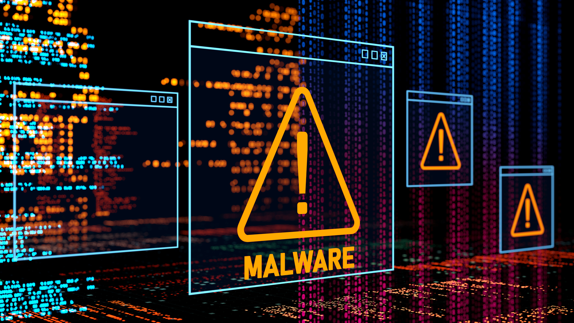


CASE STUDY 1 – THE "SILENT" BREACH (PAYMENT GATEWAY)
Detection
Containment
Notification
May 31, 2022
July 20, 2022
August 11, 2022
Internal red flag raised when the internal IT team discovered the breach and classified it as an incident and not a glitch.
Green Checkmark - Technically Fixed. The IT team marked the case as internally resolved.
"Public Informed"
73 DAYS OF SILENCE

Slide 20
CASE STUDY 1 – THE "SILENT" BREACH (PAYMENT GATEWAY)
The Scenario: A payment gateway breach compromising card data.
  Technical Response: Successful. The breach was contained by July 20.
  Strategic Response: Delayed. Public/Regulators notified ~2.5 months after detection.
The "Act 854" Reality Check (If this happened today):
  Violation: Section 23 mandates notification when an incident "might have" occurred.
  The Gap: 73 Days vs. 6 Hours (Regulatory Deadline).
The Consequence (If this happened today):
  Regulatory: RM 500k Fine + Up to 10 Years Jail (Section 23).
  Liability: Directors are personally liable under Section 58.
  Insurance: Likely denial of coverage due to "Late Reporting" breach.

Slide 21
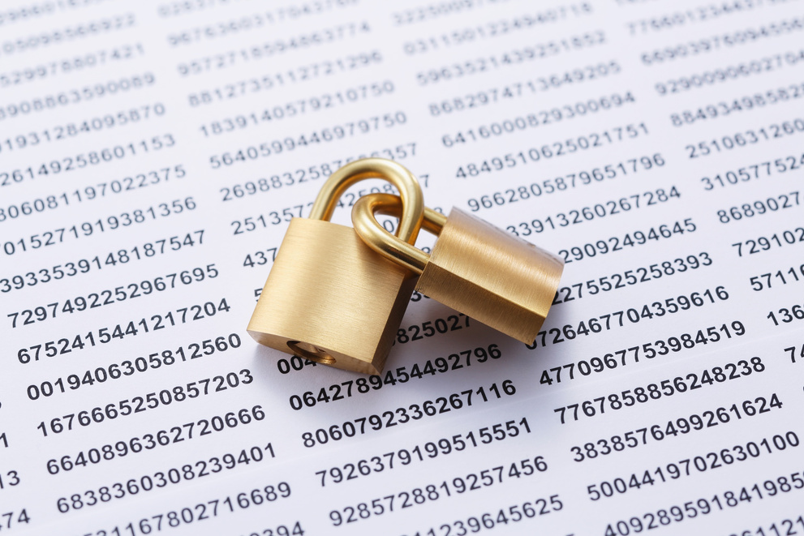
CASE STUDY 2 – RANSOMWARE HOSTAGE (LOW COST CARRIER)
Detection
The Impact
The Tactic
Nov 2022
5 Million Passenger & Staff records leaked. Hackers publicly stated they stopped the attack not because of AirAsia's defences, but because the network was so chaotic and disorganised that they got annoyed sifting through it.
"Double Extortion"
(Encryption + Exfiltration). AirAsia refused to pay. From a 'Business Continuity' view, that is brave. But the hackers then published the data.
Daixin Team Ransomware.

Slide 22
CASE STUDY 2 – RANSOMWARE HOSTAGE (LOW COST CARRIER)
The Incident: Nov 2022. Daixin Team Ransomware.
  The Impact: 5 Million Passenger & Staff records leaked.
  The Tactic: "Double Extortion" (Encryption + Exfiltration).
The Dilemma:
  Option A: Restore from backup (Ignores the data leak).
  Option B: Pay the ransom (Illegal? Unreliable? Stops the leak?).
Act 854 Reality:
  Duty to Protect (Section 21): The attackers mocked the "chaotic" security. Under Act 854, "chaotic security" is now evidence of negligence, punishable by up to RM 500k fine.

Slide 23
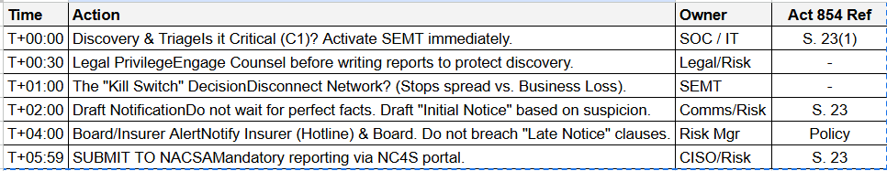
THE RISK MANAGER'S INCIDENT BATTLE PLAN
THE "6-HOUR" BATTLE PLAN

Slide 24
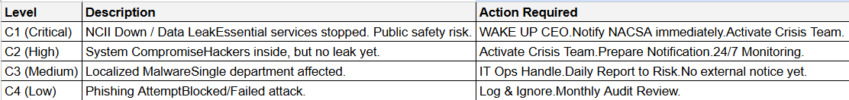
THE RISK MANAGER'S INCIDENT BATTLE PLAN
[INCIDENT TRIAGE MATRIX (The "Wake Up The Boss" Test)
Q1: Is this a "Cyber Security Incident"?
  Definition (Act 854): An act that jeopardizes confidentiality, integrity, or availability.
Q2: What is the Severity?
Q3: The Golden Rule
  "If you are debating whether to notify, the answer is usually YES." Under Act 854, silence is a crime.

Slide 25
THE REALITY CHECK
"FORENSIC COSTS"
"LEGAL DEFENSE FEES"
"DATA RESTORATION"
"PR FIRM RETAINERS"
"RANSOM PAYMENTS (POLICY DEPENDENT)"
"ACT 854 CRIMINAL FINES (RM 500K)"
"DIRECTORS' JAIL TIME (UP TO 10 YEARS)"
"REPUTATIONAL RUIN / LOST TRUST"
"INSURANCE PAYS FOR THE CLEANUP. IT DOES NOT PAY FOR THE CRIME."

