Slide 1
The Illusion of speed
How rushing decisions without mature processes increases organisational fragility

Slide 2
Speed without structure doesn’t accelerate progress — it accelerates collapsE

Slide 3
SPEED AS A COMPETITIVE MYTH
We’ve confused urgency with strategy

Slide 4
ORGANISATIONAL FRAGILITY: THE HIDDEN COST
THE STORM
Market Crisis | AI | ESG |Pandemic |Regulation
Company A
Company B
Company C
💥 FRAGILE
Processes fail
People panic
Blame starts
🛡️ ROBUST
Processes hold
People respond
Recovery begins
🚀 ANTIFRAGILE
Processes improve
People learn
Competitive advantage grows

Slide 5
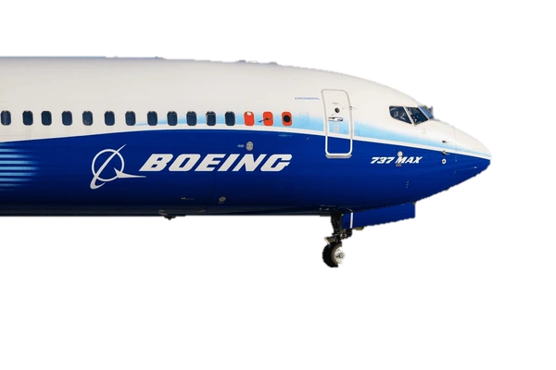
CASE STUDY: Boeing 737 MAX
IMPACT:
2 CRASHES
346 DEATHS
US$ 20 BILLION
Prioritised speed and cost savings
MCAS was rushed into service
Safety warnings were not acted upon
THE FRAGILITY WAS ALWAYS THERE – HIDDEN BENEATH STRONG FINANCIAL RESULTS UNTIL IT WASN’T
Notes:
Prioritised speed and cost savings over a new aircraft design.
MCAS was rushed into service with critical safety flaws.
Internal safety warnings were not acted upon.
Financial performance took priority over engineering investment.
Two crashes killed 346 people and caused major losses.
Investigations revealed weak board-level safety oversight.
Speed-to-market replaced engineering rigour. The process maturity was absent. The fragility was always there — hidden beneath strong financial results until it wasn’t.

Slide 6
FRAGILITY IS NOT DRAMATIC. IT IS THE QUIET ACCUMULATION OF EVERY SHORTCUT TAKEN IN THE NAME OF SPEED

Slide 7
PROCESS MATURITY AS THE REAL COMPETITIVE ADVANTAGE
Slow is smooth. Smooth is fast.
Notes:
“We romanticise speed. But in risk, the fastest decision is often the most expensive one.”

Slide 8
WHAT IS PROCESS MATURITY?
REPEATABILITY
AUDITABILITY
RESILIENCE TO PRESSURE

Slide 9
BUILDING THE CONDITIONS WHERE FAST IS ALSO SAFE
Pillar 1
Decision rights clarity
Pillar 2
Pre-mortem practice
Pillar 3
Psychological Safety as a Risk Tool
Pillar 4
Non-financial Risk on Board Agenda

Slide 10
First thing to do tomorrow morning,…
Run a decision audit
Map your decision rights
Add a pre-mortem to board or exco agenda
Build esg data infra

Slide 11
SPEED WITH WISDOM IS AGILITY
SPEED WITHOUT WISDOM IS JUST EXPOSURE

Slide 12
THANK YOU

